Slide 1

Lesson 9:
Area Under the Curve

Slide 2


Introduction

Slide 3

Lecture Overview:
Goals of the lecture:
Determine how to calculate the area under the curve

Slide 4
Area Under the Curve

Slide 5
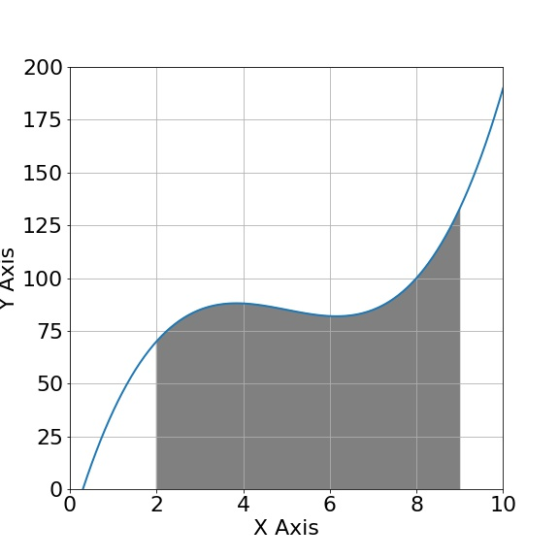
Area Under the Curve

Slide 6
Area Under the Curve

Slide 7

Area Under the Curve
$$A=f(x)∆x$$

Slide 8

Area Under the Curve
$$A=f(x)∆x$$
$$∆x$$

Slide 9
Area Under the Curve

Slide 10
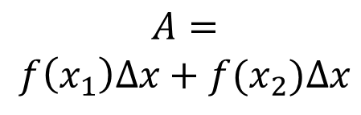
Area Under the Curve
$$A=$$
$$f\left(x_{1}\right)∆x+f(x_{2})∆x$$

Slide 11

Area Under the Curve
$$A=$$
$$f\left(x_{1}\right)∆x+f(x_{2})∆x$$
$$∆x$$

Slide 12
Area Under the Curve

Slide 13
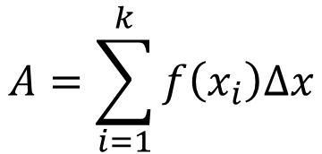
Area Under the Curve
$$A=\sum_{i=1}^{k}{f\left(x_{i}\right)∆x}$$

Slide 14

Area Under the Curve
$$A=\sum_{i=1}^{k}{f\left(x_{i}\right)∆x}$$
$$∆x$$

Slide 15
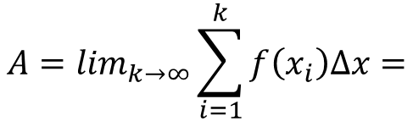
Area Under the Curve
$$A=\lim_{k→∞}\sum_{i=1}^{k}{f\left(x_{i}\right)∆x=}$$

Slide 16
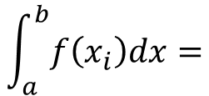
Area Under the Curve
$$A=\lim_{k→∞}\sum_{i=1}^{k}{f\left(x_{i}\right)∆x=}$$
$$\int_{a}^{b}{f\left(x_{i}\right)dx=}$$

Slide 17
Area Under the Curve
$$A=\lim_{k→∞}\sum_{i=1}^{k}{f\left(x_{i}\right)∆x=}$$
$$\int_{a}^{b}{f\left(x_{i}\right)dx=}$$
a b

Slide 18

Area Under the Curve
$$A=\lim_{k→∞}\sum_{i=1}^{k}{f\left(x_{i}\right)∆x=}$$
$$\int_{a}^{b}{f\left(x_{i}\right)dx=}$$
$$F\left(b\right)−F(a)$$
a b

Slide 19
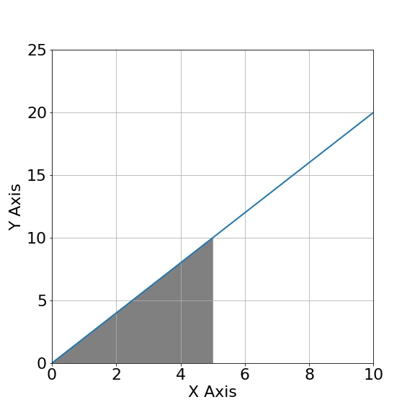

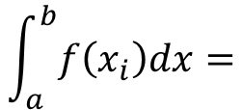
Area Under the Curve
$$\int_{a}^{b}{f\left(x_{i}\right)dx=}$$
$$F\left(b\right)−F(a)$$

Slide 20

Area Under the Curve
$$\int_{a}^{b}{f\left(x_{i}\right)dx=}$$
$$F\left(b\right)−F(a)$$
$$A= \frac{b∙h}{2}=\frac{5∙10}{2}=25$$

Slide 21
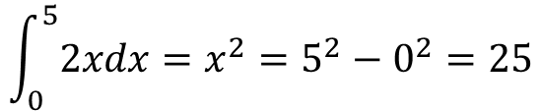
Area Under the Curve
$$\int_{a}^{b}{f\left(x_{i}\right)dx=}$$
$$F\left(b\right)−F(a)$$
$$A= \frac{b∙h}{2}=\frac{5∙10}{2}=25$$
$$\int_{0}^{5}{2xdx=x^{2}=5^{2}−0^{2}=25}$$

Slide 22
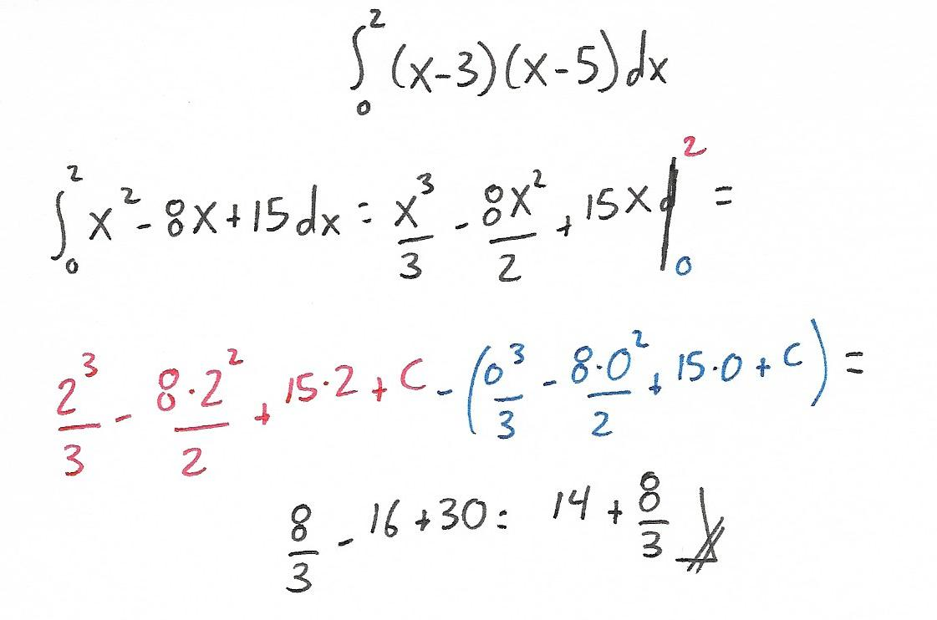
Problem 1:
Problem 1: Calculate the AUC.

Slide 23
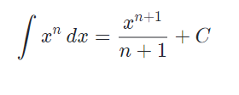

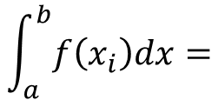
Problem 1:
Problem 1: Calculate the AUC.
$$\int_{a}^{b}{f\left(x_{i}\right)dx=}$$
$$F\left(b\right)−F(a)$$

Slide 24
QUESTIONS?

